Slide 1
PROFFESIONAL RELEVANT PLATFORMS
DANIELLA KADIMA

Slide 2
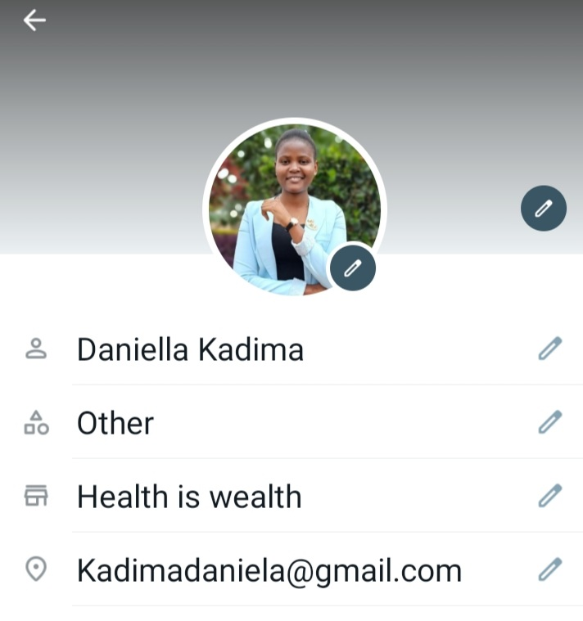
WHATSAPP-0700441662

Slide 3
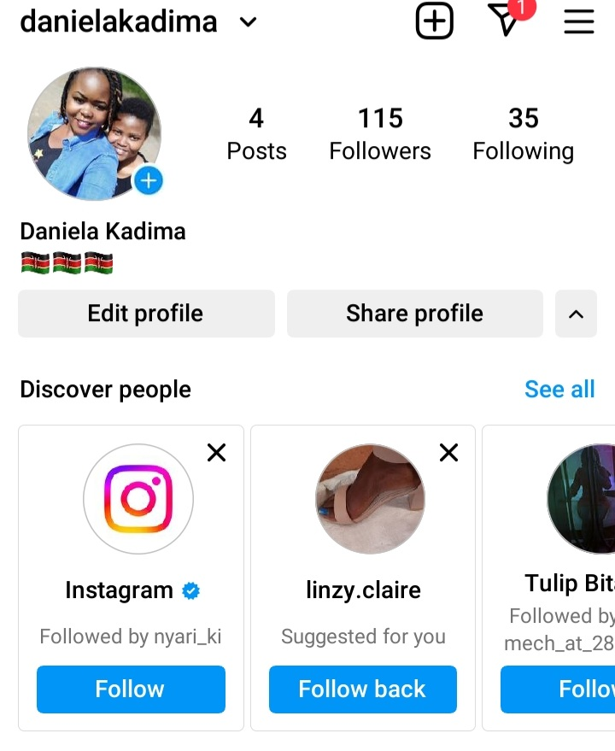
INSTAGRAM-#danielakadima

Slide 4
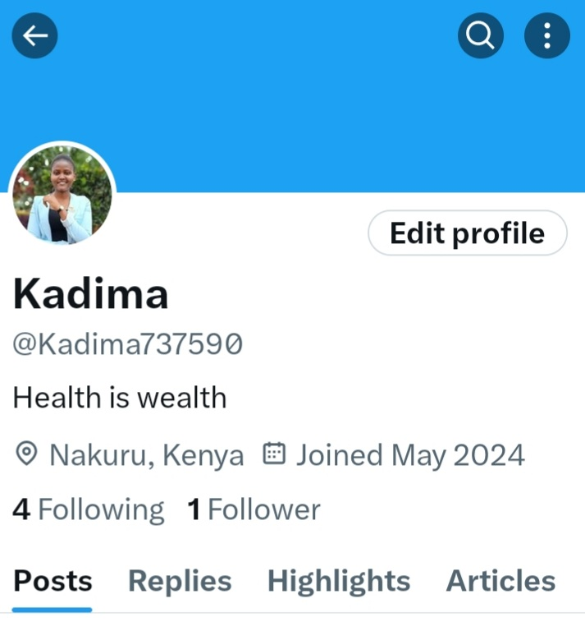
X-@Kadima737590

Slide 5
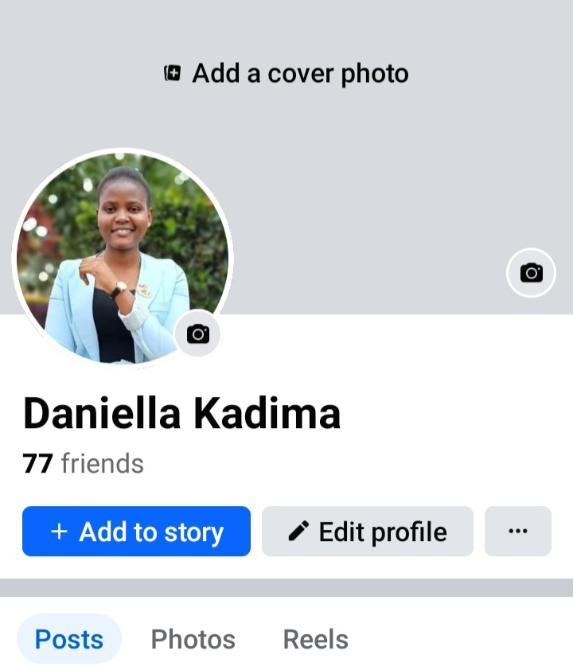
FACEBOOK-DANIELLA KADIMA

Slide 6
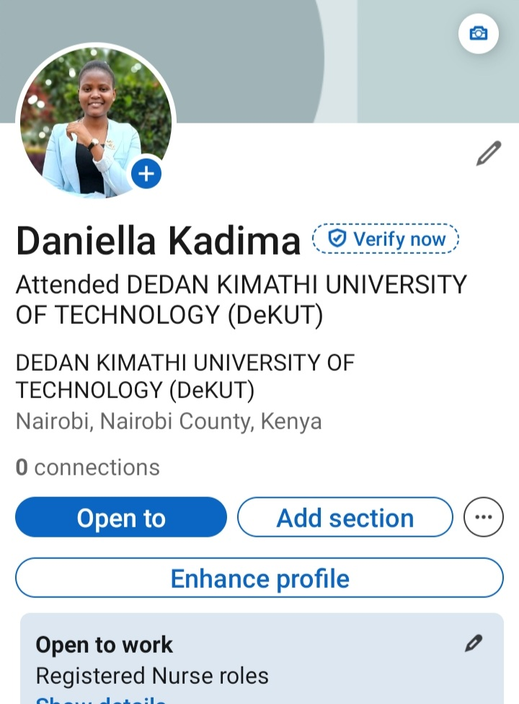
LINKEDIN DANIELLA KADIMA

